Slide 1
Schema Management At Scale
How Cloudflare enables 100s of engineers to modify ClickHouse schemas
DATE : 2022-07-14

Slide 2

Who is this dude?
Working as a team of 5 focusing on ClickHouse and tooling.
What we do:
  Cluster upgrades
  Tooling & Automation.
What we use ClickHouse for:
  HTTP and DNS Analytics
  Traffic and Bot Management
  Cloudflare Worker runtime analysis
  ..lots!
Sean Haynes
Systems Engineer @Cloudflare
(ClickHouse Team)

Slide 3

ClickHouse at Cloudflare
35 clusters
744 physical machines
1108 table definitions
~ 38 PiB storage on-disk
~ 2 schema changes a day (682 in 12 months)
NVME Replica
HDD Replica
x 10 3.5TB NVMEs
x 12 10TB HDDs
256 GB RAM
256 GB RAM
AMD EPYC (48 cores)
Intel Xeon 6210U (20 cores)

Slide 4
What is Schema Management?
The process of explicitly defining both incremental changes and the absolute state of your database schema.
  Incremental changes - Schema Migrations (defined below)
  Absolute state - For reprovisioning/bootstrapping your database.
The ability to apply and revert those definitions in your database.
“In software engineering, a schema migration (also database migration, database change management) refers to the management of version-controlled, incremental and reversible changes to database schemas.”
https://en.wikipedia.org/wiki/Schema_migration
Notes:
As I’ve been referencing Schema Management, let’s explain what that is to me.

Slide 5

Why bother?
Definitive state of what the schema should be.
Unmanageable with a large amount of tables/views.
Process to review schema changes.
Access control may mean people don’t have access to view schemas

Slide 6
How we used to define schemas
CREATE DATABASE IF NOT EXISTS dbname.exciting_table;
CREATE TABLE IF NOT EXISTS dbname.exciting_table
(
`date` Date,
`dateTime` DateTime,
`count` UInt32
)
ENGINE = ReplicatedMergeTree('/clickhouse/{cluster}/tables/{shard0}/exciting_table', '{replica}')
PARTITION BY toYYYYMM(dateTime)
ORDER BY dateTime;
├── cluster-1
│ ├── bootstraps
│ │ └── inspiring-table-001.sql
│ └── migrations
│ ├── inspiring-table-001.down.sql
│ └── inspiring-table-001.up.sql
└── cluster-2
├── bootstraps
│ └── exciting-view-001.sql
└── migrations
├── exciting-view-001.down.sql
└── exciting-view-001.up.sql

Slide 7

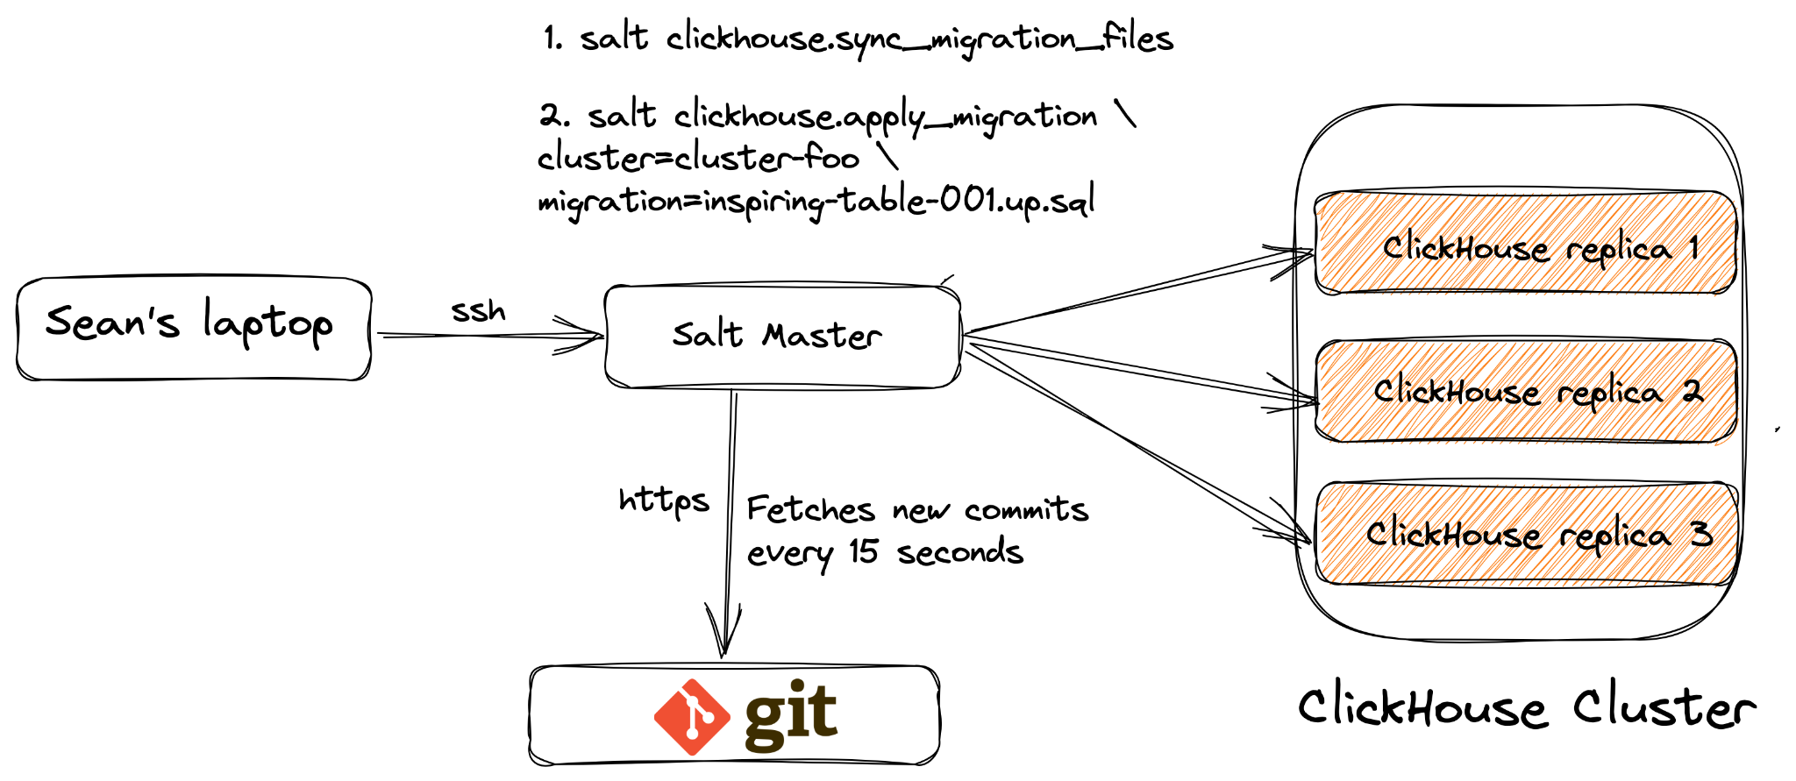
How we used to do migrations..

Slide 8
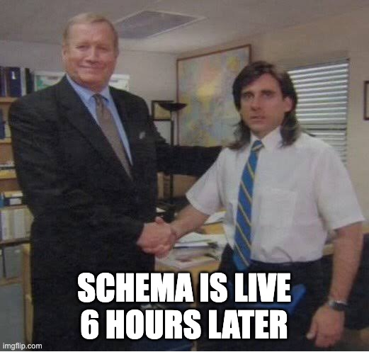
Problems?
Manual and time consuming process
Error prone
Not scalable due to human operations
Static (years old) SQL statements can bite us when syntax changes on newer ClickHouse versions.

Slide 9
What did we want?
High-level, declarative means to define schema. E.g yaml
Automated deployment & rollback
State and metrics on deployments
Empower Engineers to release their own schemas.

Slide 10
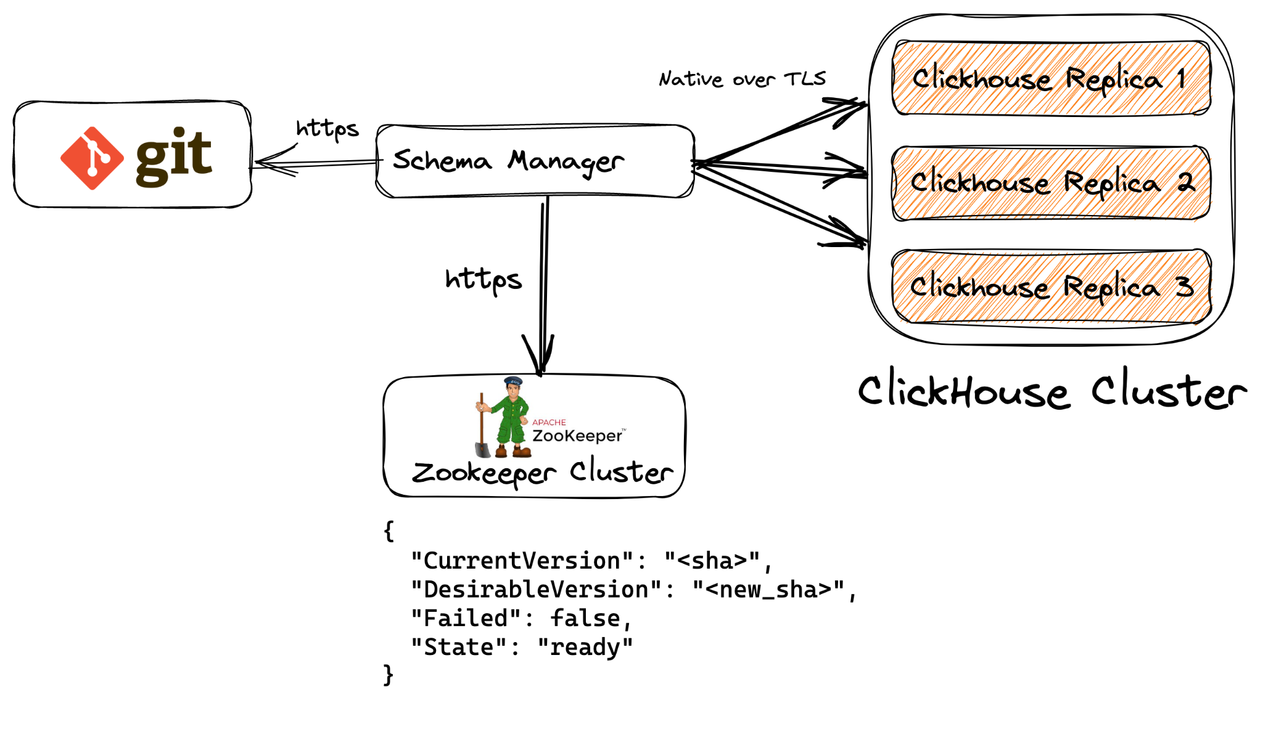
Schema Manager
Continuously fetches new commits by monitoring HEAD of configured branch.
Generates SQL and executes on all replicas.
Stores version and state in zookeeper.

Slide 11
Generates required SQL
tables:
- name: exciting_table
db: dbname
columns:
date:
type: Date
dateTime:
type: DateTime
count:
type: Int32
engine:
partition: toYYYYMM(dateTime)
type: MergeTree
replicated: true
primaryKey:
- dateTime
CREATE DATABASE IF NOT EXISTS dbname;
CREATE TABLE IF NOT EXISTS dbname.exciting_table
(
`date` Date,
`dateTime` DateTime,
`count` UInt32
)
ENGINE = ReplicatedMergeTree('/clickhouse/{cluster}/tables/{shard0}/exciting_table', '{replica}')
PARTITION BY toYYYYMM(dateTime)
ORDER BY dateTime;

Slide 12
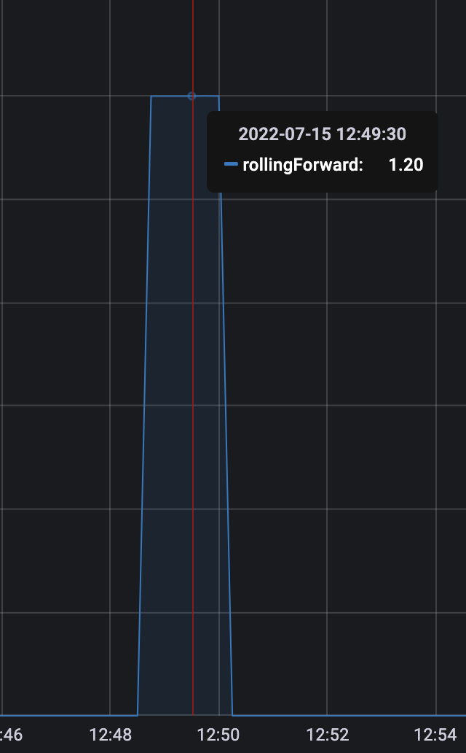
Schema Manager states
Has both Cluster and Node states
FSM. Available finite states:
  Empty
  Ready
  Critical
Transitional states (e.g Empty to Ready)
  Initialization
  RollingForward
  RollingBackward

Slide 13
What’s next?
Table retention/TTLs
UI component
Open source version?

